Slide 1
Probabilistic Programming
Corina Ilinca
corina.ilinca@outlook.com
December 4, 2018

Slide 2
About projects
First project due date: Thursday, December 6, 10 am.
Please send your projects to the following e-mail address:
corina.ilinca@outlook.com
Professor Marius Popescu is presenting the task for the second project next time, on December 11.

Slide 3
Data analysis: a couple of research articles I coauthored - mainly in the frequentist logic – Question for today: Which parts can be approached using the Bayesian logic?

Slide 4
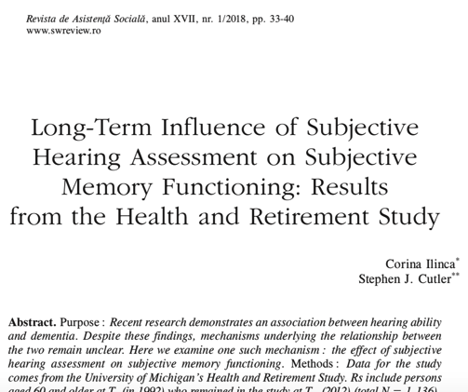

Slide 5
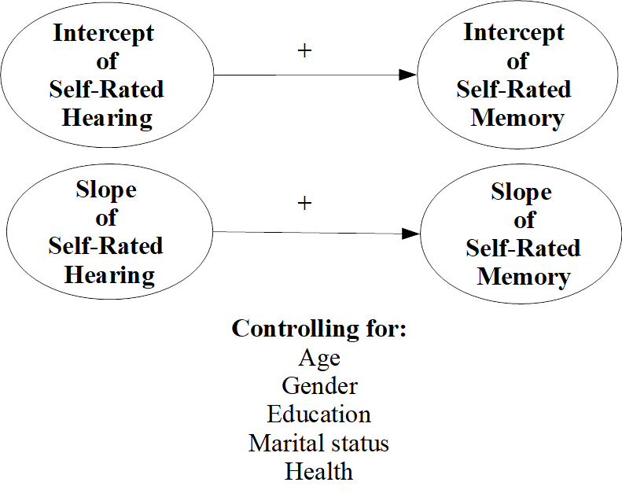
Structure of the article (Ilinca and Cutler 2018)
Literature review: the importance of hearing for memory – the main hypothesis
Methodology: latent growth curve modeling within a structural equation model
Results: descriptive (univariate statistics) and multivariate statistics based on the model tested
Conclusions: implications of results in comparison with the literature.
Conceptual diagram:

Slide 6
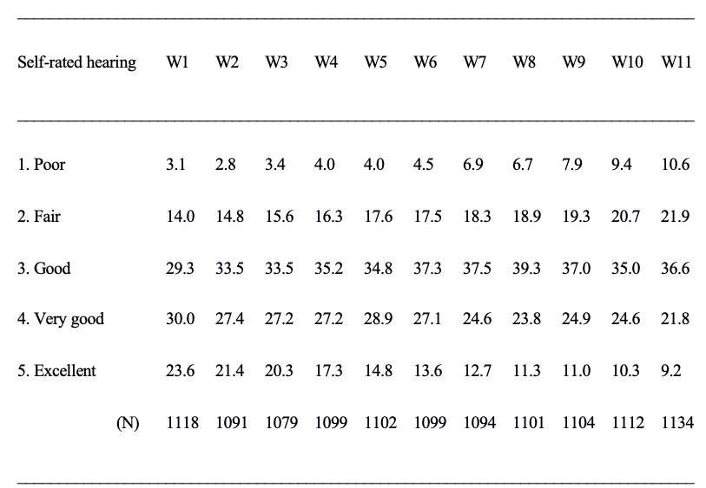
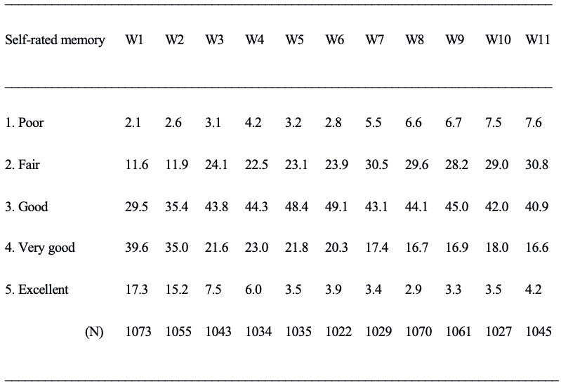
Descriptive statistics of main variables (Ilinca and Cutler 2018)

Slide 7
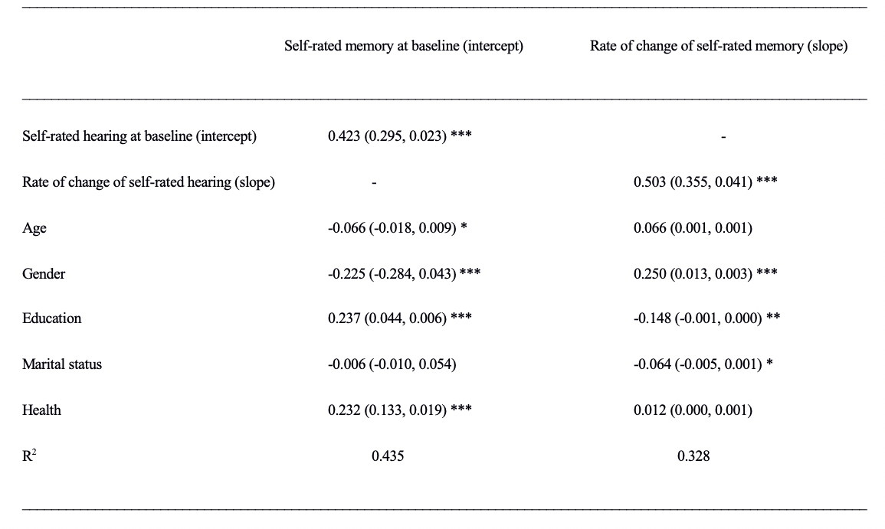
Note: ”Standardized coefficients. In parentheses: unstandardized coefficients and standard errors. *** p<0.001, ** p<0.01, *p<0.05. The sample is composed by individuals of 60 years of age and older in 1992” (Ilinca and Cutler 2018).

Slide 8


Slide 9
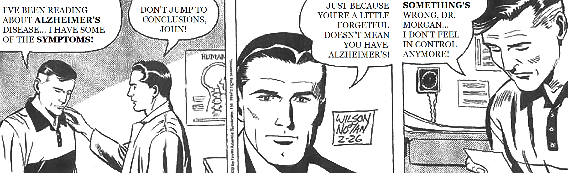
REX MORGAN, 2/26/2002 apud Cutler and Brăgaru 2017 – part of the presentation of the article

Slide 10
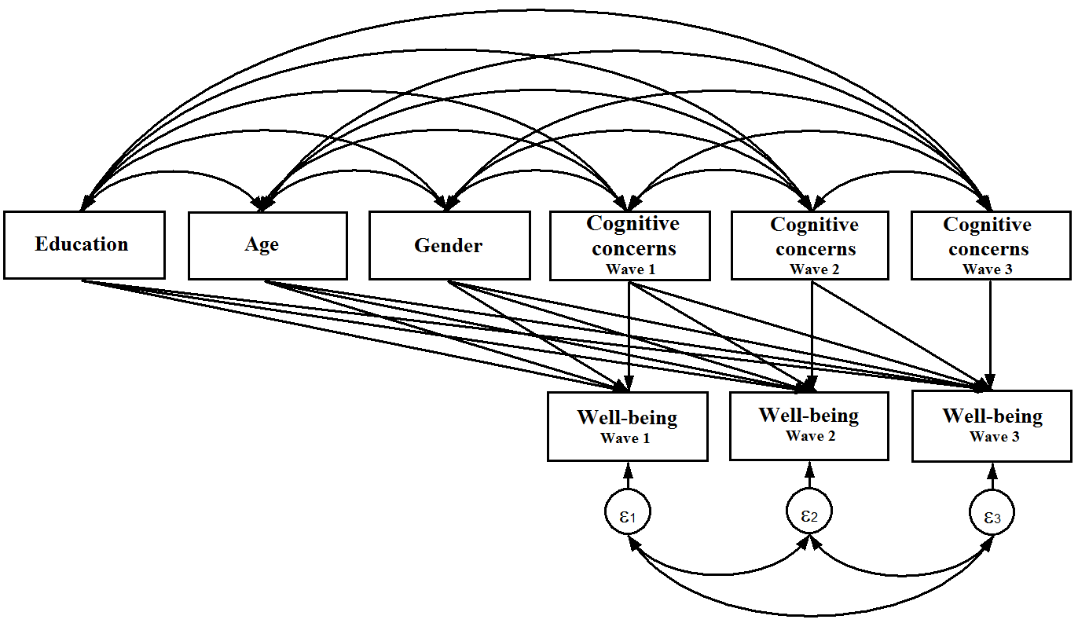
Structure of the article (Cutler and Brăgaru* 2017)
Literature review: influence of cognitive concerns on psychological well-being
Methodology: longitudinal structural equation model with three waves of data; cognitive concerns are summative scores on several indicators (e.g. worry about dementia,ability to remember, experiences of changing memory).
Differences between using summative scores, exploratory factor analysis (EFA) with resulted factorial scores or confirmatory factorial analysis with reflective or formative factors included in the model.
*Brăgaru was my name before getting married.

Slide 11
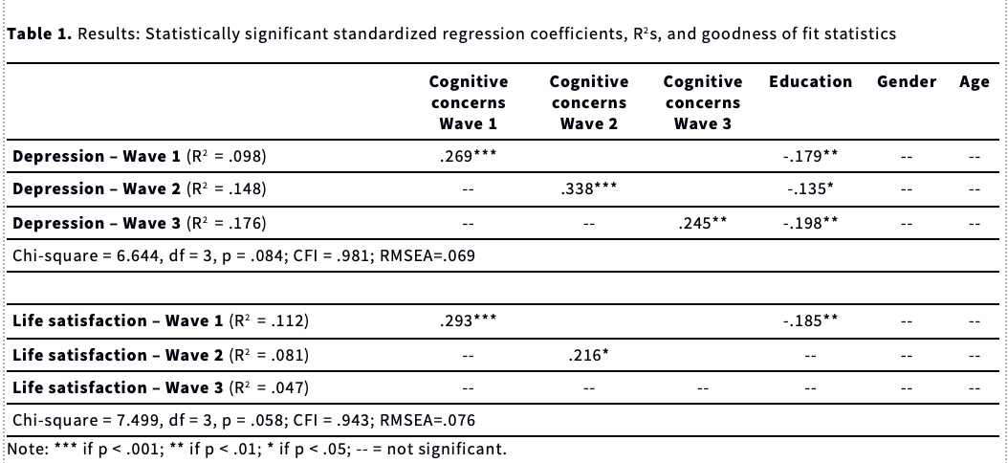
Source: Cutler and Brăgaru 2017

Slide 12
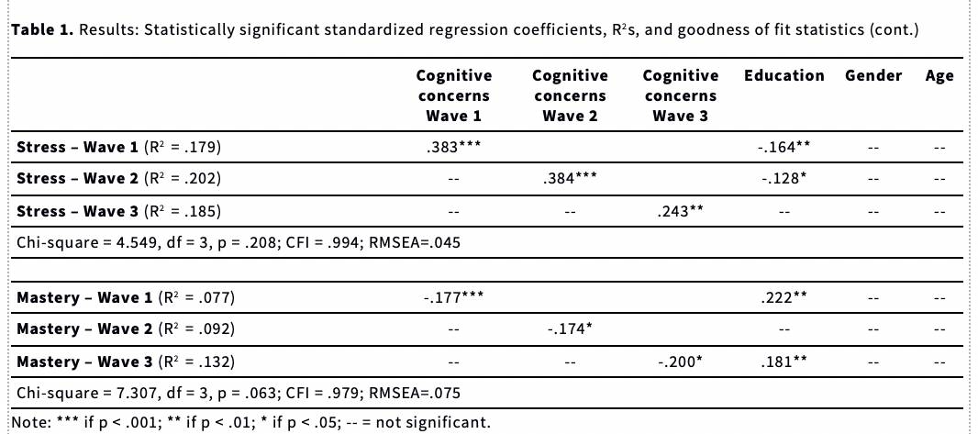
Source: Cutler and Brăgaru 2017

Slide 13
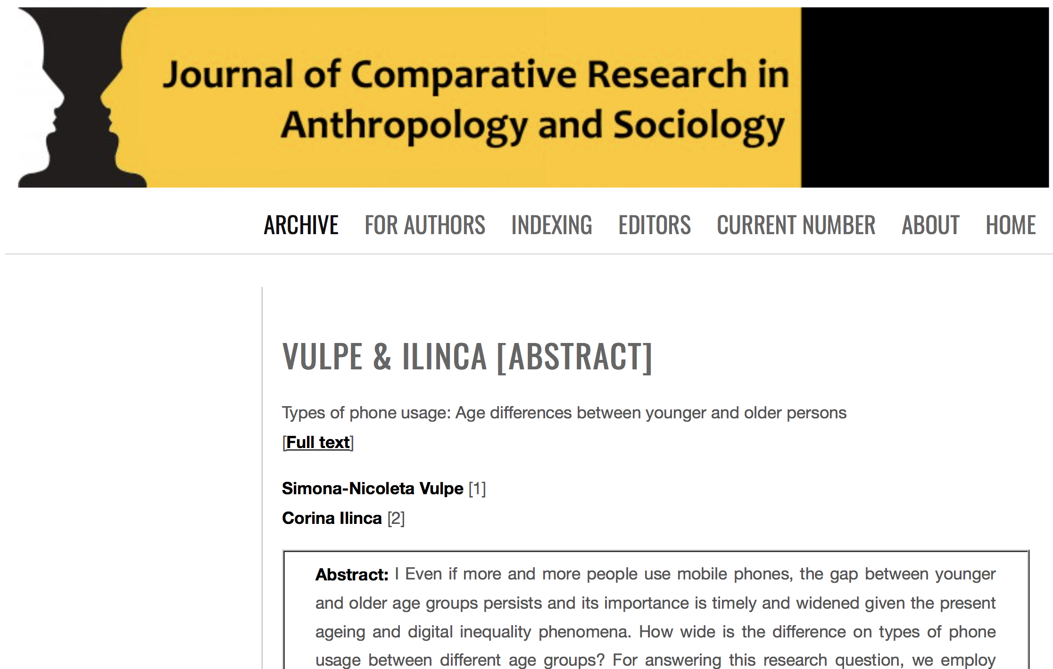

Slide 14
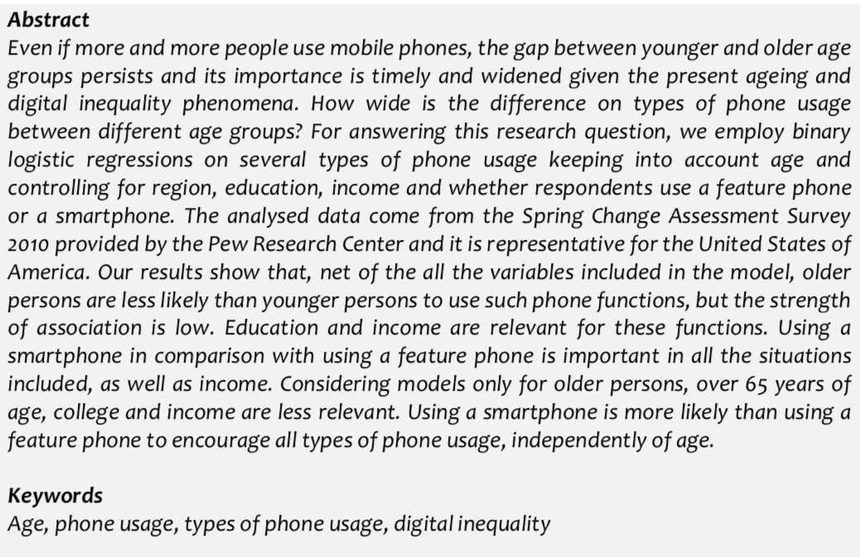
Abstract of the article (Vulpe and Ilinca 2017)

Slide 15
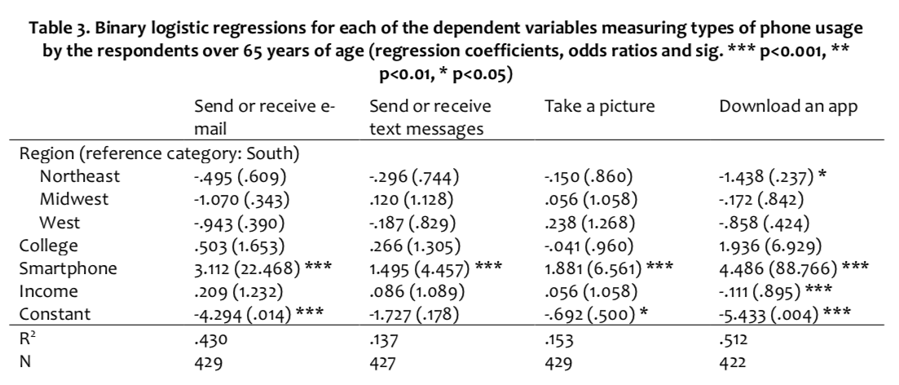
Source: Vulpe and Ilinca 2017

Slide 16
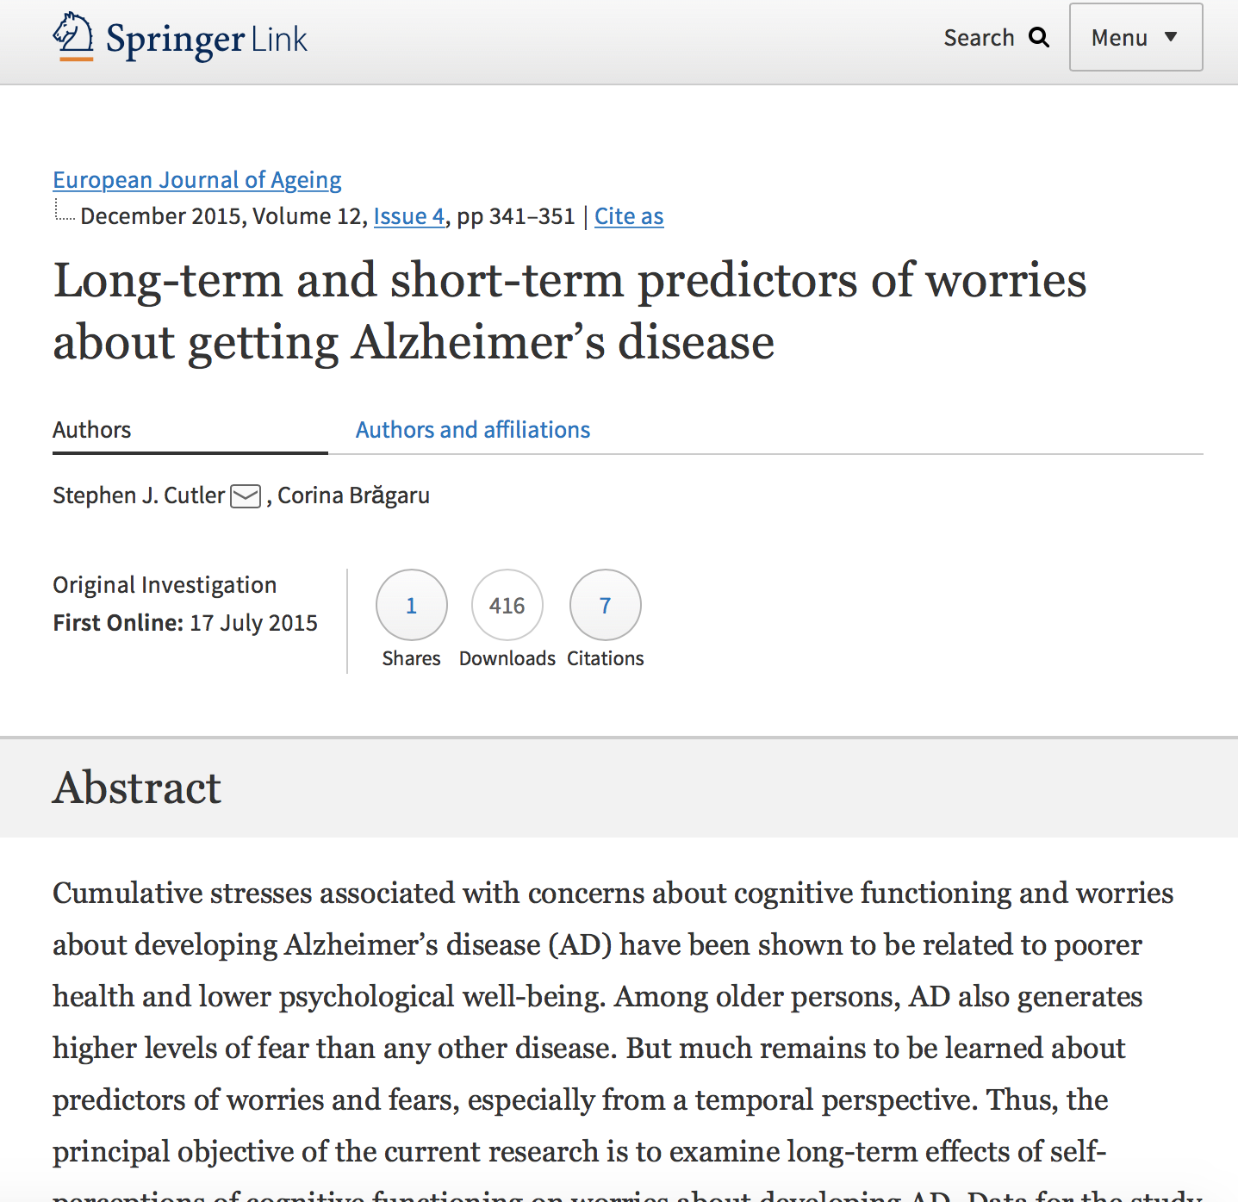

Slide 17
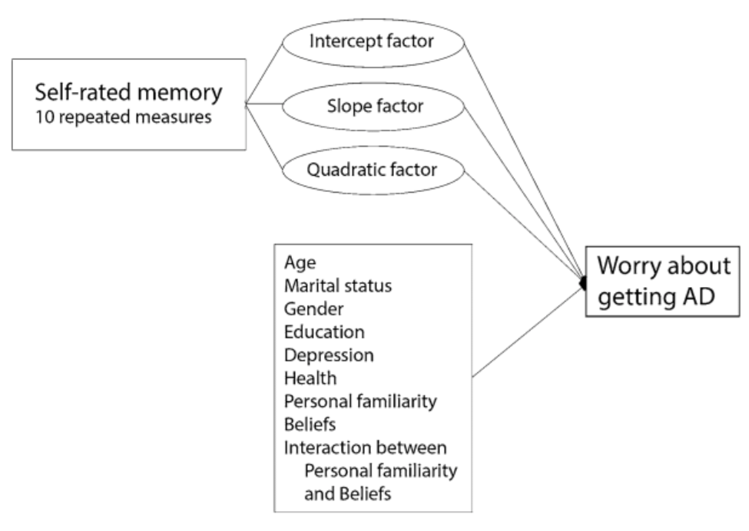
Structure of the article (Cutler and Brăgaru 2015)
Literature review: importance over time of self-rated memory on worry about getting Alzheimer disease
Methodology: latent growth curve modeling within a structural equation model; 10 waves of data from the Health and Retirement Study.

Slide 18
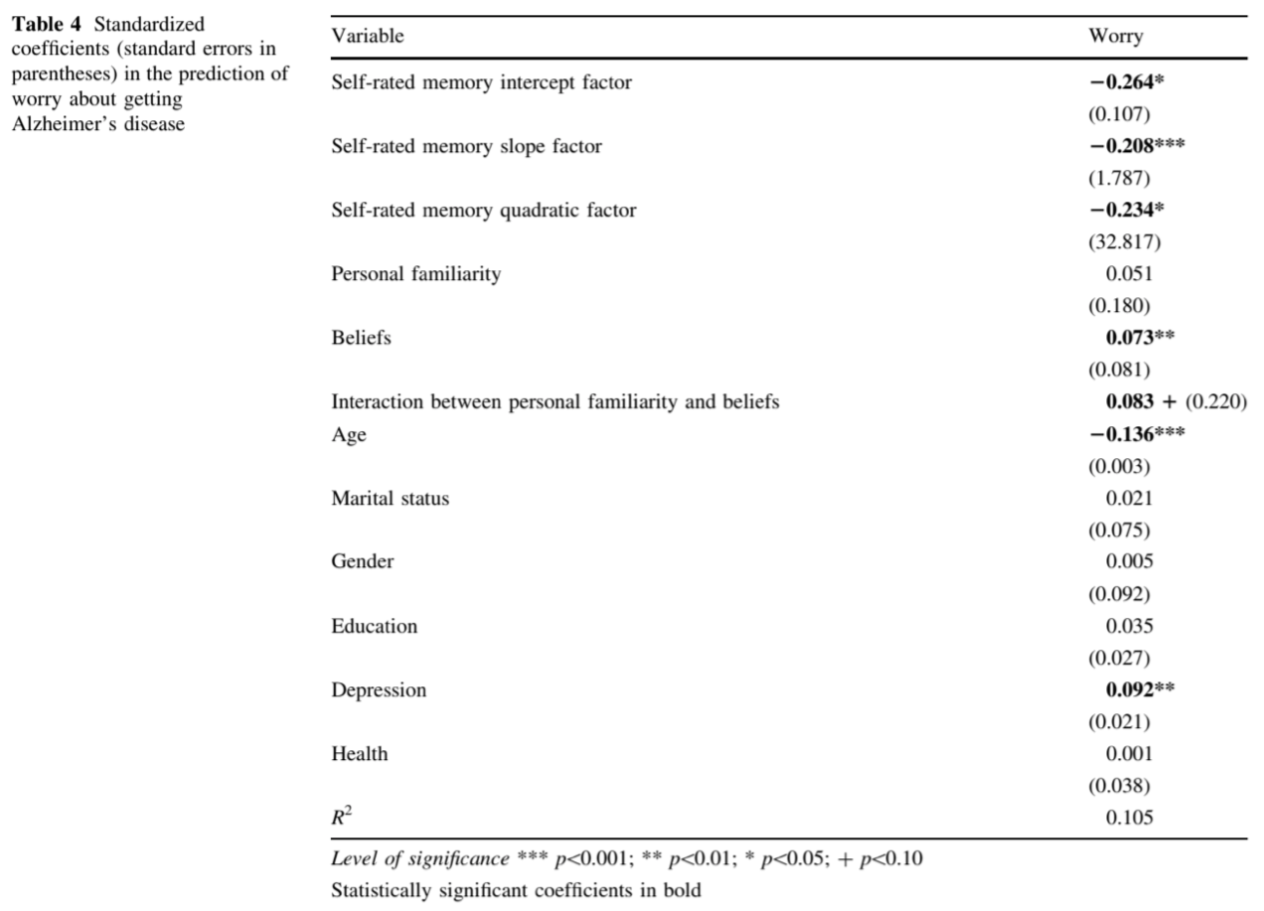
Source:
Cutler and Brăgaru 2015

Slide 19
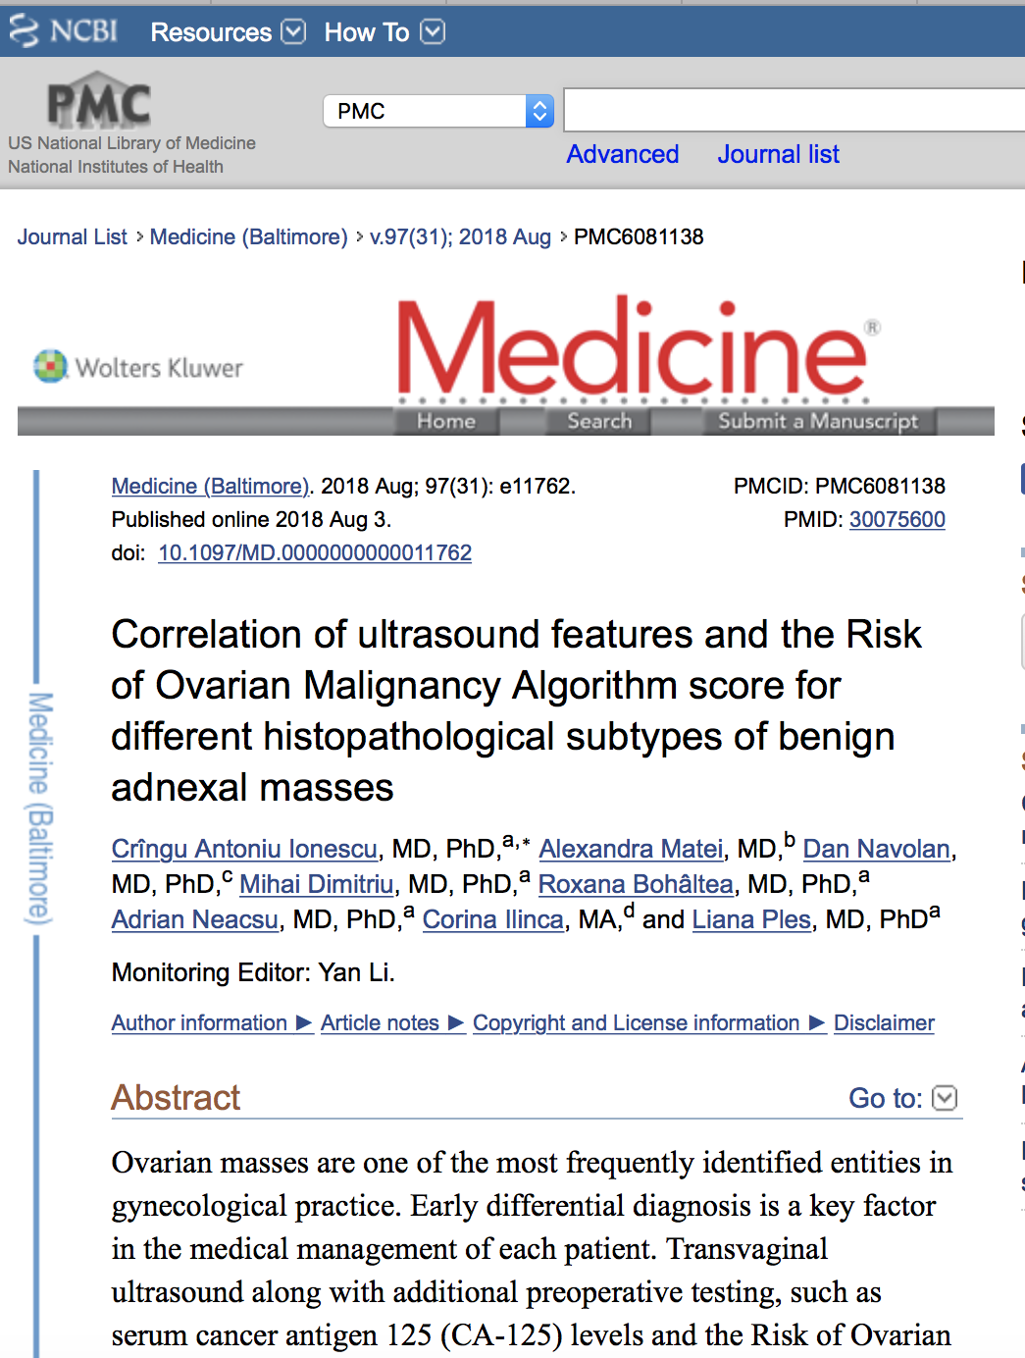

Slide 20
”Histograms of risk of ovarian malignancy algorithm scores and cancer antigen 125 levels for pre/postmenopausal groups. ROMA score for premenopausal (A) and postmenopausal (C) patients. CA-125 levels of premenopausal (B) and postmenopausal (D) patients. CA-125 = cancer antigen 125, ROMA = Risk of Ovarian Malignancy Algorithm.”
(Ionescu et al. 2018)

Slide 21
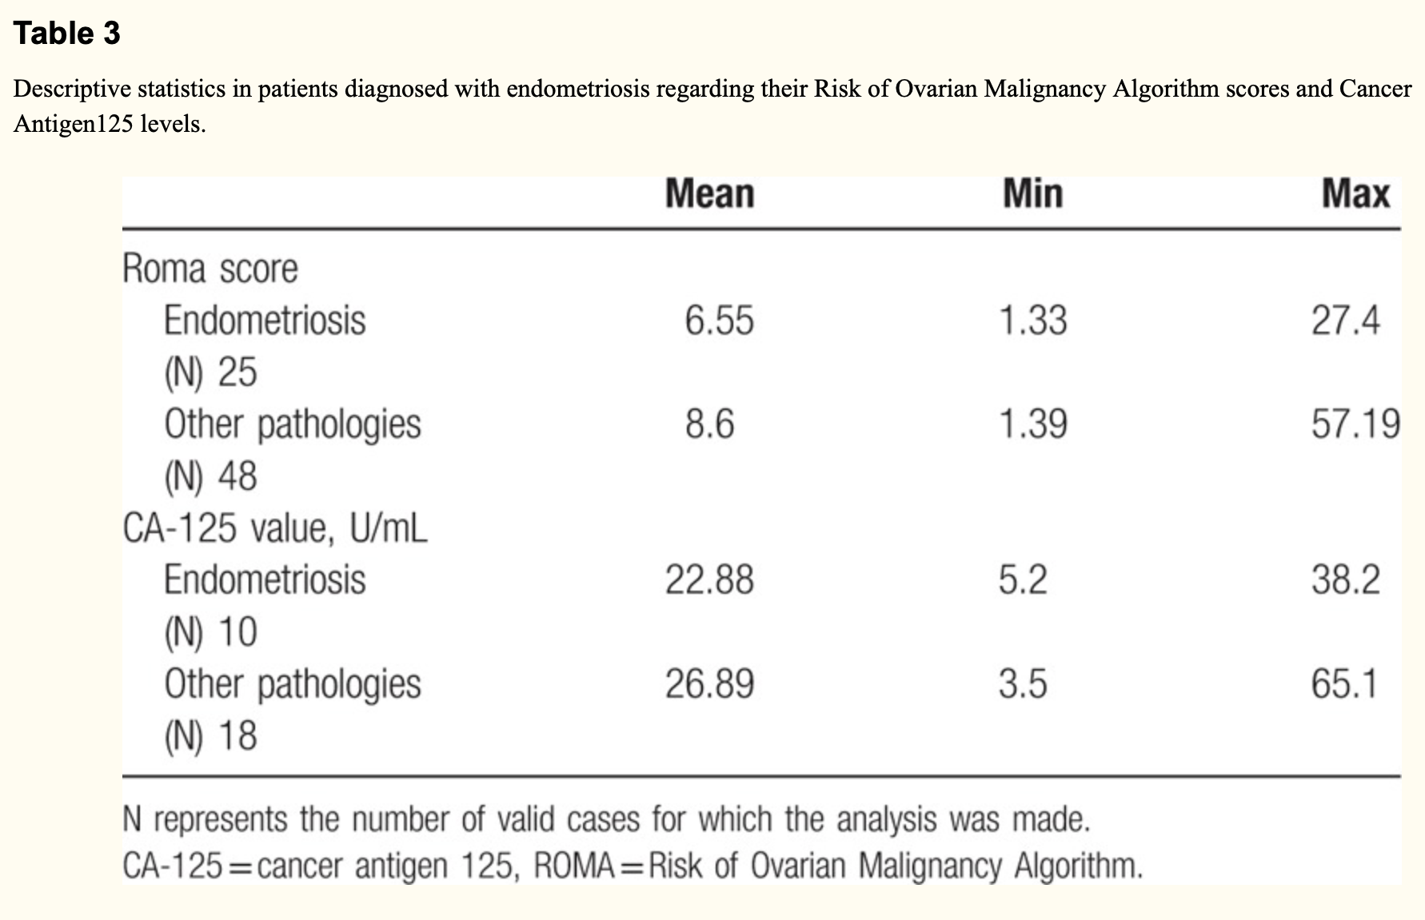
Source: Ionescu et. al 2018

Slide 22
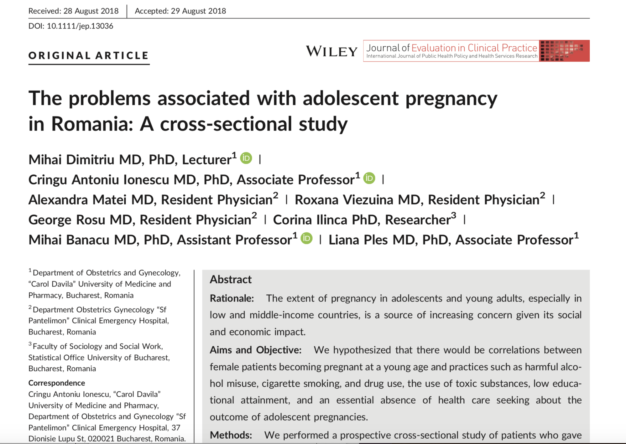

Slide 23
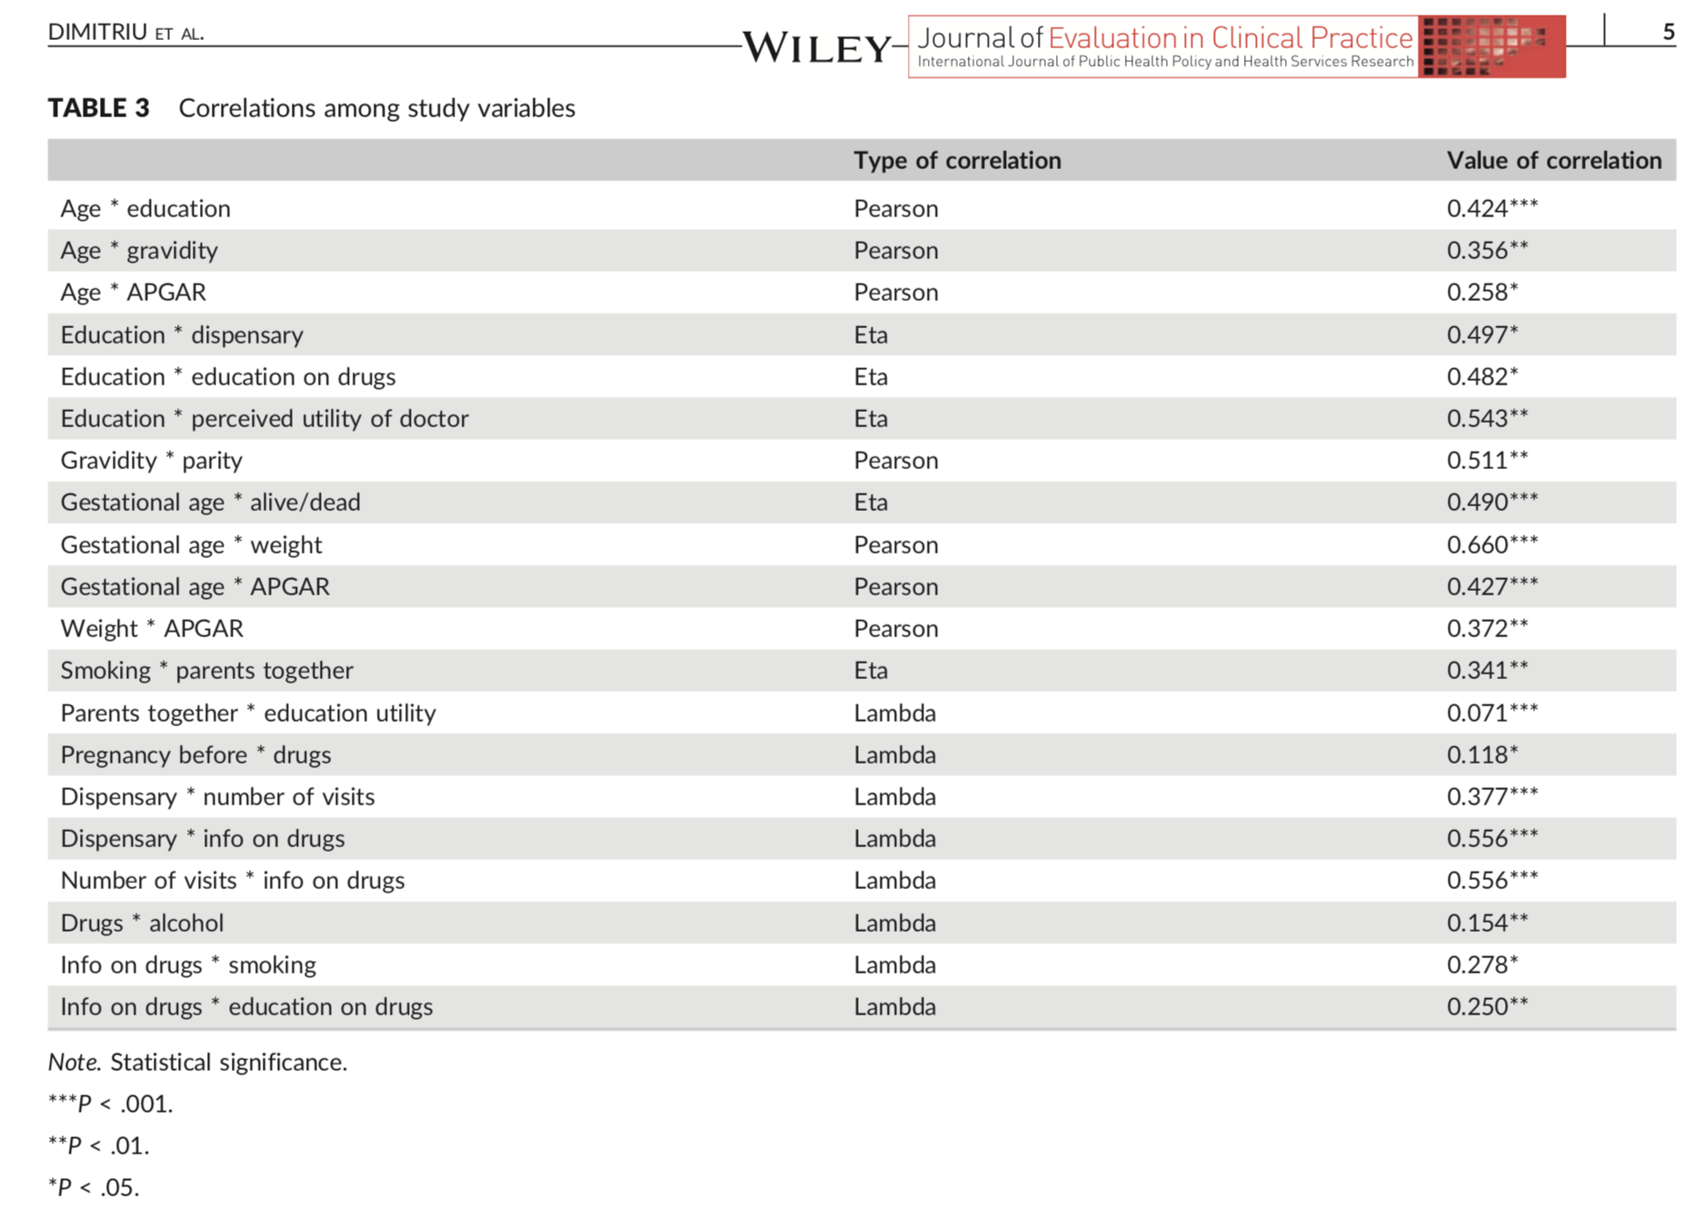
Source: Dimitriu et. al 2018

Slide 24
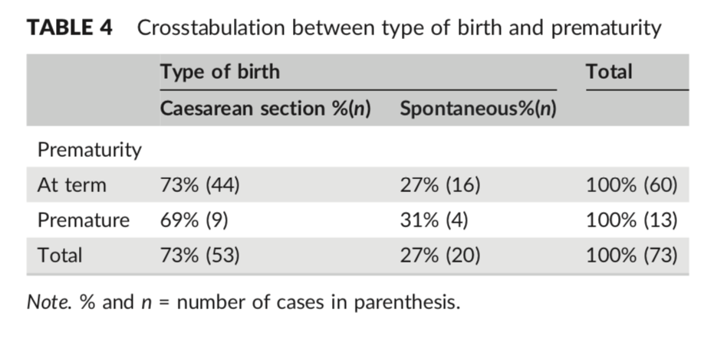
Source: Dimitriu et. al 2018.
Example for reading percentages in the table: 27% of at term births were spontaneous.
Incorrect reading:
27% of spontaneous births were at term.

Slide 25
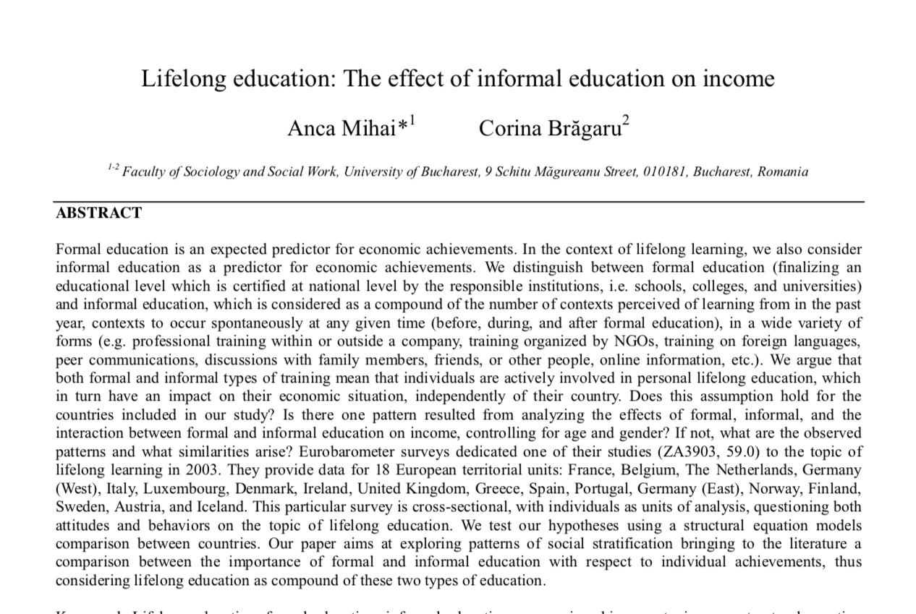

Slide 26
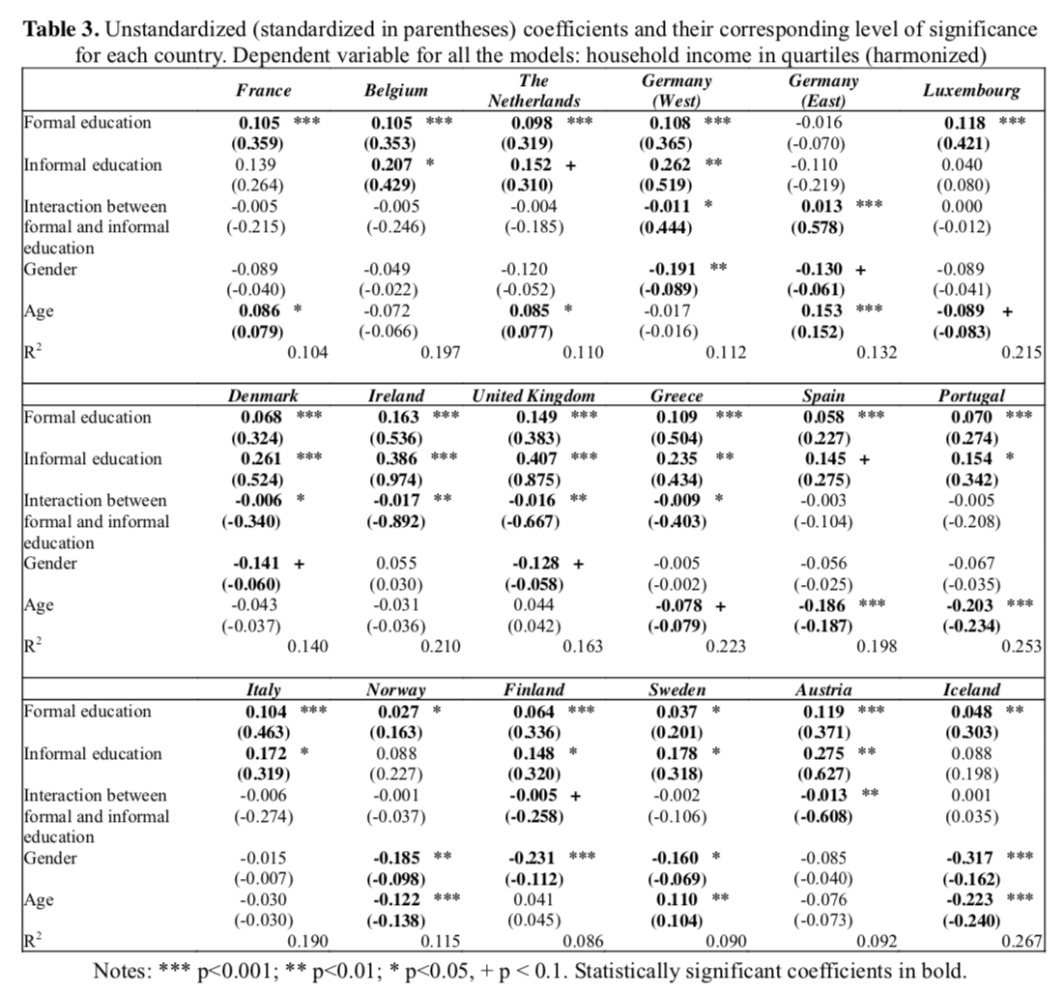
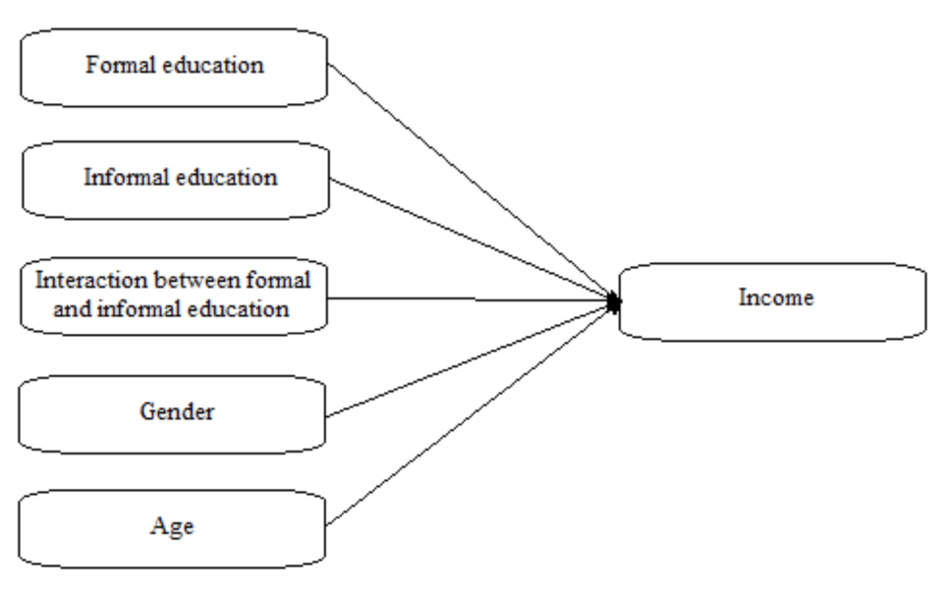
Source: Mihai and Brăgaru 2015

Slide 27
Sources of data - examples freely available for research):
The Health and Retirement Study (HRS, for the USA) http://hrsonline.isr.umich.edu
The Survey of Health, Ageing and Retirement in Europe (SHARE) http://www.share-project.org
World Values Survey http://www.worldvaluessurvey.org/wvs.jsp
Eurobarometer http://ec.europa.eu/commfrontoffice/publicopinion/index.cfm/Chart/index

Slide 28
Archives with datasets (freely available for research)
GESIS ZACAT
https://zacat.gesis.org/webview/
IPUMS
https://international.ipums.org/international-action/variables/group?id=h-econ
UK data archive
http://data-archive.ac.uk
Gateway to Global Aging Data
https://g2aging.org

Slide 29
Mainly different types of regression. Other new steps?
Reading the dataset in Python – example: dataset created for SPSS
https://pypi.org/project/savReaderWriter/
https://stackoverflow.com/questions/14647006/is-there-a-python-module-to-open-spss-files
Recoding data
https://pythonfordatascience.org/recode-data/

Slide 30
Cited works:
Cutler, Stephen J. and Corina Brăgaru. 2017. “Do Worries About Cognitive Functioning and Concerns About Developing Alzheimer’s Disease Affect Psychological Well-Being?” Journal of Aging and Health 29(8):1271–87.
Cutler, Stephen J. and Corina Brăgaru. 2015. “Long-Term and Short-Term Predictors of Worry about Getting Alzheimer’s Disease.” European Journal of Ageing 12(4):341–51.
Dimitriu, Mihai et al. 2018. “The Problems Associated with Adolescent Pregnancy in Romania: A Cross‐sectional Study.” Journal of Evaluation in Clinical Practice.
Ilinca, Corina and Stephen J. Cutler. 2018. “Long-Term Influence of Subjective Hearing Assessment on Subjective Memory Functioning: Results from the Health and Retirement Study.” Social Work Review 17(1):33–40.
Ionescu, Crîngu Antoniu et al. 2018. “Correlation of Ultrasound Features and the Risk of Ovarian Malignancy Algorithm Score for Different Histopathological Subtypes of Benign Adnexal Masses.” Medicine 97(31):e11762.
Mihai, Anca and Corina Brăgaru. 2015. “Lifelong Education: The Effect of Informal Education on Income.” in International Conference on Lifelong Education and Leadership for All, October 29-31. Olomouc, Czech Republic.
Vulpe, Simona Nicoleta and Corina Ilinca. 2017. “Types of Phone Usage: Age Differences between Younger and Older Persons.” Journal of Comparative Research in Anthropology and Sociology 8(2):103–13.

